Slide 1
Microbiology Dep.
Second year
Parasitology
6th Lec.
Lecturer: Assist prof.
Dr.Sally Ahmed
Subphylum: Ciliophora
The ciliate protozoa (Ciliophora) constitute a large group characterized by numerous cilia. Many ciliates are free living and larger numbers are intestinal parasites. Ciliates have two types of nuclei, a large macronucleus and nearby a small micronucleus. Multiplication is by transverse binary fission, many species undergo conjugation, during which exchange of nuclear materials occurs. The only ciliate that is parasite of human is Balantidiun coli.
Balantidium coli
Disease: Balantidiasis
Forms of life (stages): Trophozoite and cyst.
Habitat: cecal and lower levels of the large intestine.
Infective stage: Mature cyst.
Reservoir host: hogs, monkeys
Biological Vector: None

Slide 2
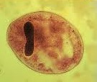
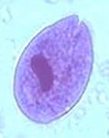
Morphology:
Cyst (figure. 1): 50 µm in diameter, spherical in shape, has no cilia.
Trophozoite (figure 2): It is the largest of protozoa that parasitize the man. 50-100 µm long, 40-70 µm wide, avoid, covered with short cilia that is constantly in motion during life, and has a vigorous forward movement. Anterior end is conical, posterior end is broadly rounded. Funnel shaped peristom lie in the anterior tip. There are one or two contractile vacuoles within the cytoplasm. The kidney shaped macromolecule lie posteriorly, and spherical micronuclei lie near the hilum of the macronuclei.
Figure 2: B. coli trophozoite in a wet mount, 500× magnification. Note the visible cilia on the cell surface.
Figure 1: B. coli cyst in a wet mount, unstained.

Slide 3
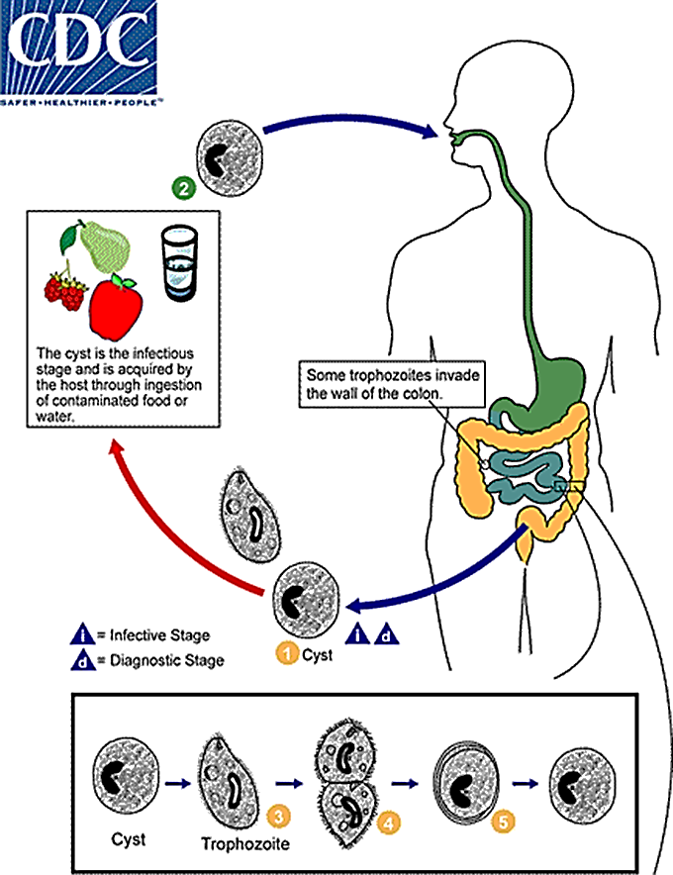
Life cycle: (figure 3)
Life cycle of Balantidium coli is simply completed by a fecal-oral route of transmission (direct life cycle), the ingested cyst when reach intestine undergo excystations, one young trophozoites librated from each cyst, the trophozoites then reproduced a sexually by transverse binary fission. Conjugation could occur between two trophozoites. Balantidium coli trophozoites feed on host cells, bacteria and other substances in the lumen of the bowel. Encystations occur under unfavorable conditions. Some of these cysts shaded irregularly to outer environment to recycle the life cycle of Balantidium coli parasite

Slide 4
Pathogenesis and Symptoms:
Three forms of B. coli infection can occur: asymptomatic cyst excretion, acute colitis, and chronic infection. Most cases are asymptomatic; patients with debilitating conditions (particularly immunosuppression) or other infections are at increased risk for developing symptomatic infection.
In sporadic cases with acute clinical manifestations, symptoms include nausea, vomiting, diarrhea, weight loss, and abdominal pain. Stools may be either watery or dysenteric. Fulminant disease is rare and is most frequently associated with fulminating dysentery with or without multiple intestinal perforations. When present, the colonic ulcers and clinical presentation are similar to those found in amebic dysentery with deep invasion of the submucosa with organisms.
In case of human and monkey balantidiasis, the multiplying trophozoites forming nests that may invade and penetrate mucosal layer of the intestine, and extensively destruct the submucosa. Where it spread out radially, causing rapid destruction of the tissue. Balantidial ulcers are oval, irregular with red undetermined edges and they may develop at any level of the large intestine.

Slide 5
Diagnosis:
Diagnosis is based on detection of trophozoites in stool specimens or in tissue collected during endoscopy. Cysts are less frequently encountered. Balantidium coliis passed intermittently and once outside the colon is rapidly destroyed. Thus stool specimens should be collected repeatedly, and immediately examined or preserved to enhance detection of the parasite.
Epidemiology:
Human balantidiasis occurs worldwide; it is most prevalent in tropical and subtropical regions and developing countries. B. coli generally occurs among pigs in warmer climates and monkeys in the tropics. Infection in humans is therefore also more common in those areas, especially in settings where hygiene is poor. Porcine fecal contamination of water or food consumed by humans is the principal means for acquisition of infection by humans. Transmission between humans can occur via the fecal-oral route.
The number of human infection with this parasite is small indeed compared with the opportunities for acquiring the infection from animal reservoirs. Once an infection has become established in man, it can be more easily transmitted from person to person.
Prevention and control:
Since balantidiasis is common in hogs and lower primates, and human infection from such sources is infrequent, protection from exposure to animal source is not indicated. In contrast protection from exposure to human sources requires attention.

